Slide 1
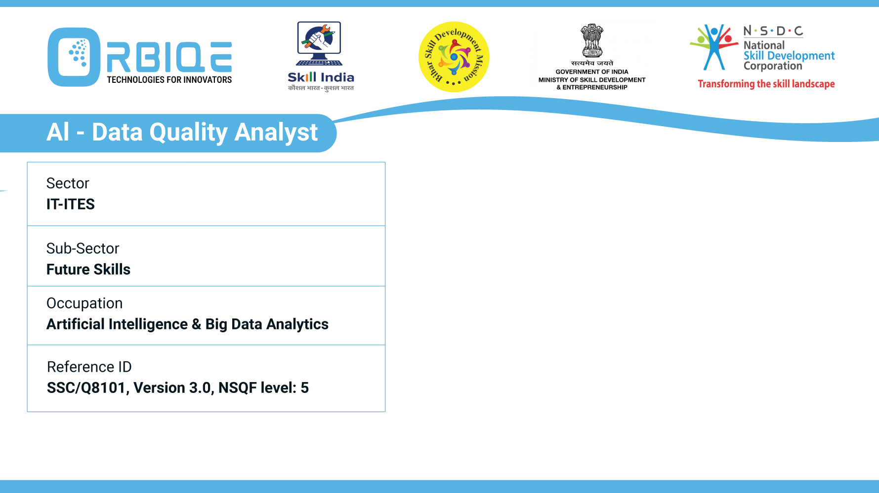
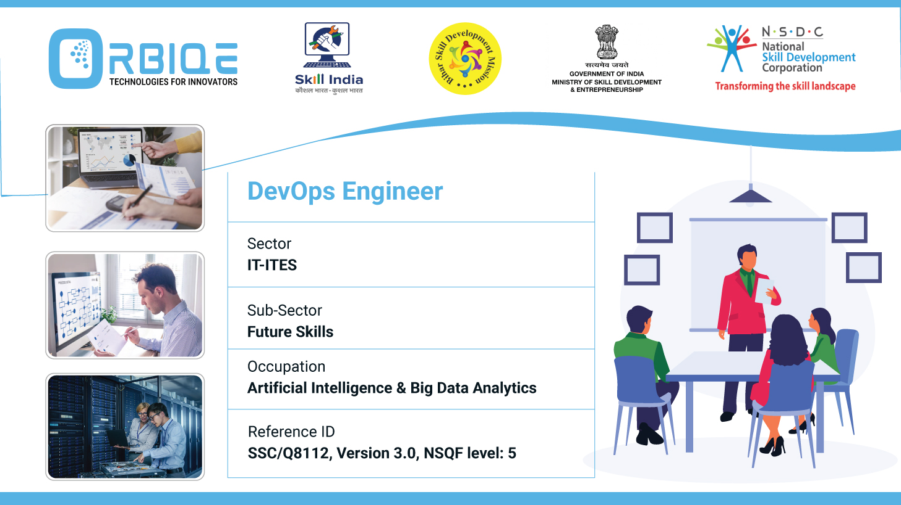
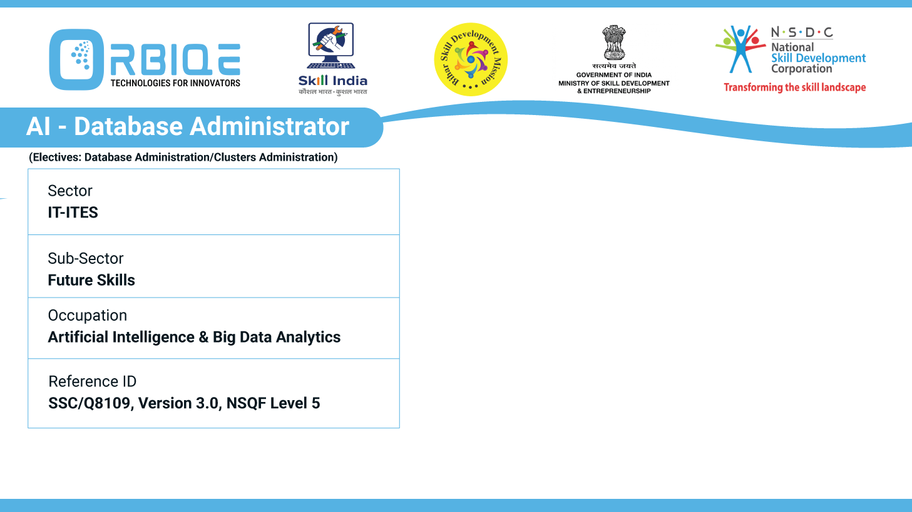
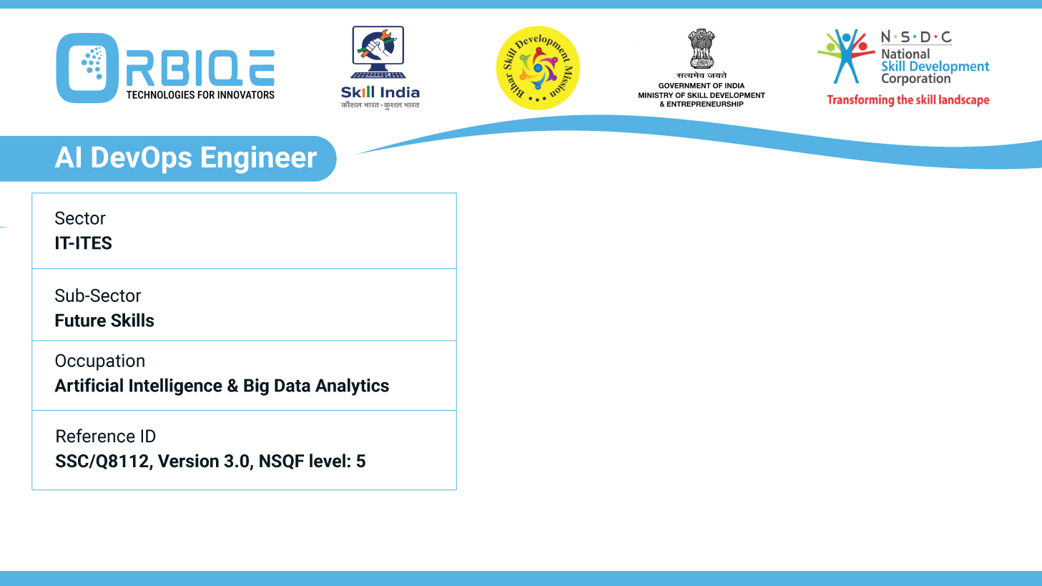
Name- Krishna Kant Dubey

Slide 2

Demystifying AI: General and Narrow Intelligence

Slide 3
Agenda
Define and differentiate between “General" and “Narrow" AI
Capabilities and limitations
Potential implications of these AI types in various contexts

Slide 4
Define and differentiate between “General" and “Narrow" AI
Narrow AI
also known as Artificial Narrow Intelligence (ANI) or Weak AI,
refers to systems designed to perform a specific task or
solve problems within a limited domain.
General AI
also known as Artificial General Intelligence (AGI) or Strong AI,
refers to machines that possess human-like cognitive abilities across a wide
range of tasks and domains.

Slide 5
Define and differentiate between “General" and “Narrow" AI
Narrow AI Characteristics:
Task-specific and domain-bound
Operates under predefined parameters
Cannot generalize beyond its training
Highly efficient within its scope
General AI Characteristics:
Can learn, reason, and adapt across domains
Exhibits autonomous decision-making
Capable of understanding context and emotions
Not limited to predefined tasks

Slide 6
Define and differentiate between “General" and “Narrow" AI
Narrow AI Examples:
Facial recognition systems
Virtual assistants like Siri, Alexa, Cortana
Recommendation engines on Netflix, Amazon, Spotify
Autonomous driving object detection modules
General AI Examples:
A robot that can learn any job a human can do
AI systems that can write code, compose music, and diagnose diseases—all without retraining
Customer service bots that understand nuanced emotions and respond empathetically

Slide 7
Narrow AI Capabilities
Task-Specific Excellence: Excels at performing well-defined tasks like facial recognition, language translation, or fraud detection.
Speed & Efficiency: Processes large datasets quickly and accurately.
Automation: Handles repetitive tasks, freeing humans for creative or strategic work.
Integration: Easily embedded into apps, websites, and devices (e.g., Siri, Alexa, recommendation engines).

Slide 8
Narrow AI Limitations
Lack of Generalization: Cannot transfer knowledge across domains or adapt to new tasks.
Data Dependency: Heavily reliant on high-quality, domain-specific training data.
No Self-Awareness: Operates without consciousness or understanding.
Context Blindness: Struggles with nuance, ambiguity, and emotional intelligence.
Ethical Constraints: Can reinforce biases if trained on flawed datasets

Slide 9
General AI Capabilities
Human-Like Reasoning: Capable of abstract thinking, problem-solving, and learning across domains.
Adaptability: Learns from minimal data and applies knowledge to unfamiliar situations.
Autonomy: Makes decisions independently, potentially with self-awareness.
Creativity & Emotion: Understands context, emotions, and can generate original ideas.

Slide 10
General AI Limitations
Technological Complexity: Requires breakthroughs in algorithms, computing power, and cognitive modeling.
Ethical Risks: Raises concerns about autonomy, control, and moral reasoning.
Lack of Real-World Deployment: Still largely theoretical; no true AGI systems exist yet.
Unpredictability: Hard to constrain or predict behavior in open-ended environments

Slide 11
Thank You

